Slide 1

EECT PROJECT Review
Case Study And Simulation on Transformers

Slide 2
Project By :
Jayant Jethi
(Roll no – 2K19/EE/127)
Krishna Gopal Kedia
(Roll no – 2K19/EE/140)
Under the guidance of
Prof. Krishna Dutt
Department of Electrical Engineering

Slide 3
Aim
Transformers are of a great use in today’s world and play a major role in the driving the world forward. In this case study, we are going to study about how transformers can be used in different scenarios for different purposes. We aim to go forward with our case study with the help of Matlab. We are going to make a live working transformer model in simulink, and write a matlab code for the same. Further, we’ll study which configuration of transformer is the best for different areas, such as a heavy use transformer which feeds heavy load industrial machines, or a transformer that feeds the household which doesn’t require such a heavy load.

Slide 4
Content
What Is Transformer
Classification On The Basis Of Supply
Three Phase Transformer
Types of connections in a 3-Φ 2-winding Transformer
Simulink Of Three Phase Transformer.
1. Circuit Design
2. Result
Result Analysis
Matlab Code
Future Aspect

Slide 5
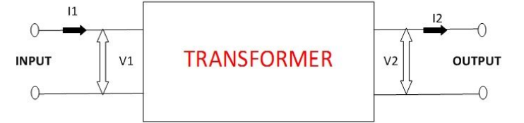
What are Transformers?
A Transformer is a static electrical machine which transfers AC electrical power from one circuit to the other circuit at the constant frequency, but the voltage level can be altered that means voltage can be increased or decreased according to the requirement. It works on the principle of Faraday’s Law of Electromagnetic Induction which states that “ the magnitude of voltage is directly proportional to the rate of change of flux.”

Slide 6
2. Classification on the basis of supply
Transformers can be classified into 2 categories based on their supply -
Single Phase Transformer - Single phase power supply operates using a single conductor
The loss in single phase is maximum
It has minimal efficiency
For home Purposes like in Microwave Oven
Three Phase Transformer - 3 phase power supply operates using three conductors
The loss in the 3 phase is minimum
It has maximum efficiency.
It is used in Large Industries.

Slide 7
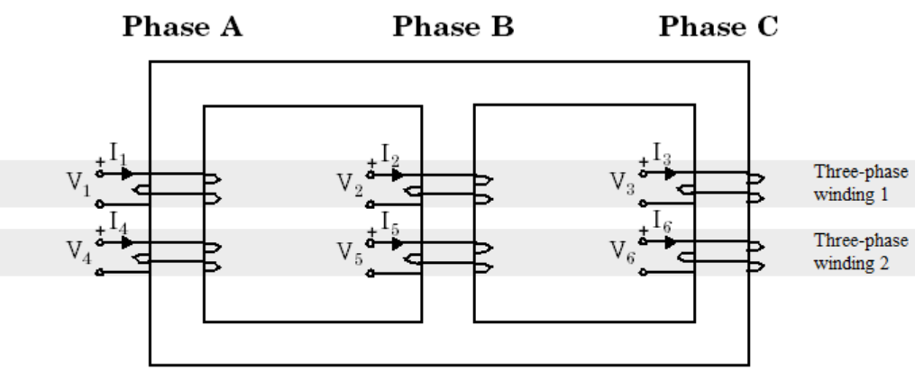
3. Three Phase Transformer
The Two-Winding Three-Phase Transformer is a three-phase transformer with a three-limb core and two windings per phase. Unlike the Three-Phase Transformer (Two Windings) block, which is modeled by three separate single-phase transformers, this transformer takes into account the couplings between windings of different phases. The transformer core and windings are shown in the following illustration.
Notes:
Recheck this slide and add a more useful definition.

Slide 8
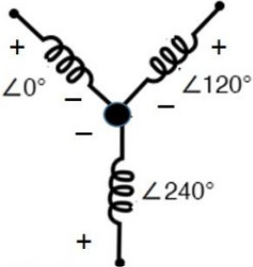
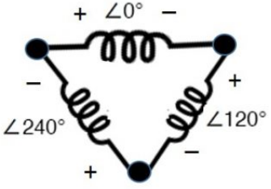
4. Types of connections in a 3-Φ 2-winding Transformer
Primary Winding | Secondary Winding
Y(start) | Y(Star)
Y(Star) | Delta
Delta | Y(Star)
Delta | Delta
STAR
DELTA
Star and Delta configurations are applied for three-phase transformers because Star connections provide the options to have multiple voltages, whereas delta configurations offer high reliability. For Star connection, either all the minus or all the plus points of windings shall be tied together. However, in delta connection, polarities of winding are connected in a converse way. The phase difference between any two phases is 120˚.

Slide 9
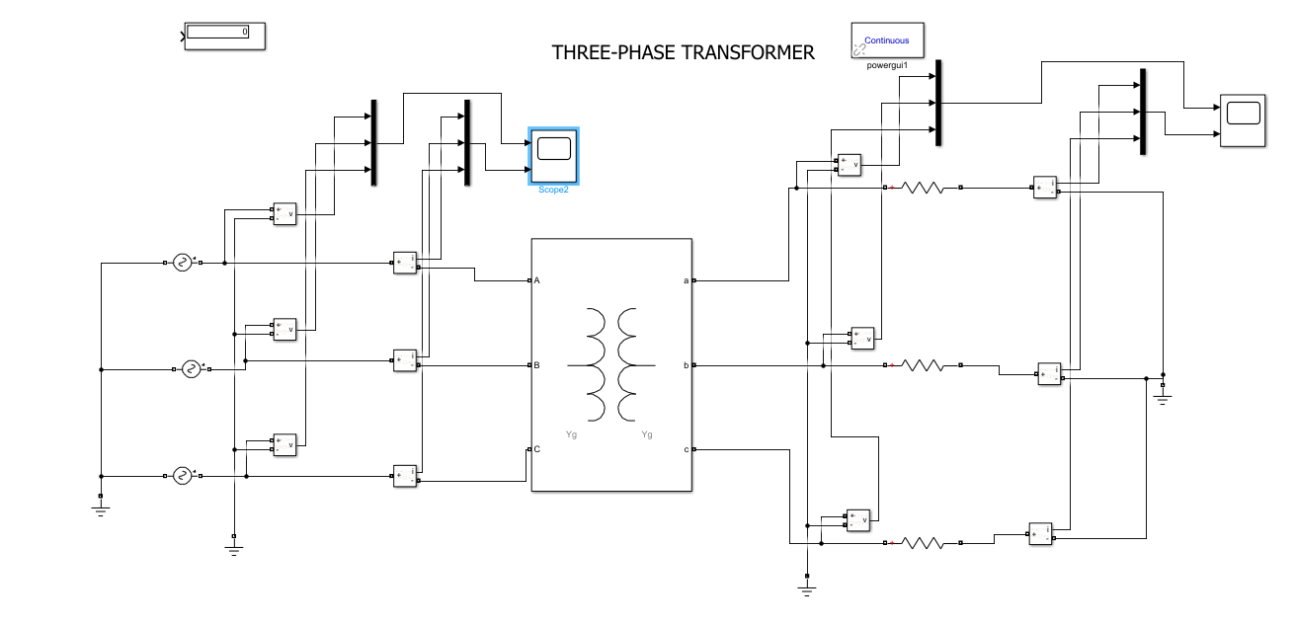
Simulink For Three Phase Transformers
Circuit Design

Slide 10
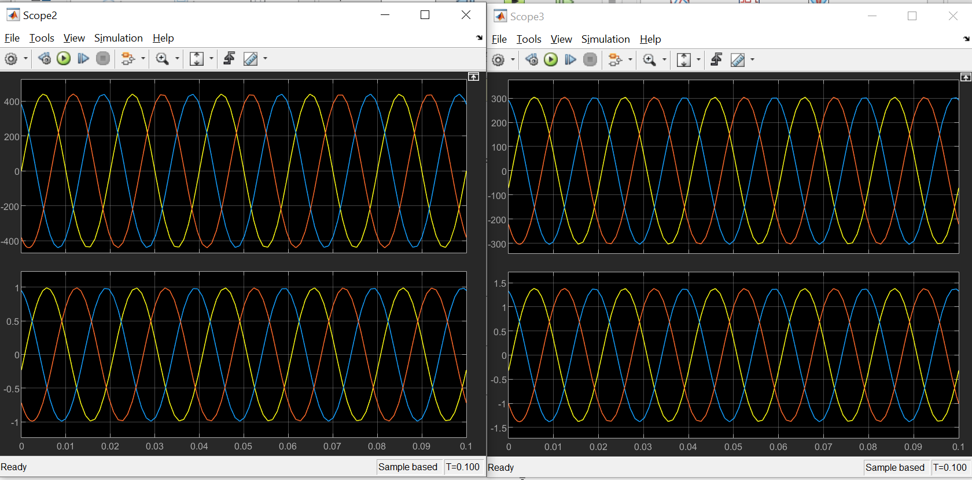
2. Results

Slide 11
Result analysis
In the simulink model, we’ve provide the transformer with 3 seperate single phase AC inputs, and after setting thee necessary parameters, we’ve measured the input and output current and voltages. In the output graphs, scope2 represent the input voltages and currents. Similarly, scope 3 represents the output voltages and current respectively.

Slide 12
Matlab Code
Vl = input('Enter line voltage:'); Il = input('Enter line current:'); n = input('Type the Turn Ratio:'); disp('Press 1 for Delta Delta connection'); disp('Press 2 for Delta Star connection'); disp('Press 3 for Star Delta connection'); disp('Press 4 for Star Star connection'); i = input('Enter your choice:'); if i == 1 disp('Delta Delta Connection'); Vp = Vl; Ip = Il/sqrt(3); Vs = Vp/n; Is = n*Vl/sqrt(3); Vo = Vp/n; Io = n*Il; elseif i == 2 disp('Delta Star Connection'); Vp = Vl; Ip = Il/sqrt(3); Vs = Vp/n; Is = n*Ip; Vo = sqrt(3)*Vs; Io = Is; elseif i==3 disp('Star Delta Connection'); Vp = Vl/sprt(3); Ip = Il; Vs = Vl/sqrt(3)*n; Is = n*Ip; Vo = Vs; Io = sqrt(3)*n*Ip; else disp('Star Star Connection'); Vp = Vl/sqrt(3); Ip = Il; Vs = nVp; Is = nIp; Vo = Vl/n; Io = nIp; end fprintf('The line voltage is: %f \n', Vl); fprintf('The line current is: %f \n', Il); fprintf('The turn ratio is: %f \n', n); fprintf('The primary voltage is: %f \n', Vp); fprintf('The primary current is: %f \n', Ip); fprintf('The seconadry voltage is: %f \n', Vs); fprintf('The secondary current is: %f \n', Is); fprintf('The output voltage is: %f \n', Vo); fprintf('The output current is: %f \n', Io);

Slide 13
Future Aspects of the project
We know that transformer have a wide range application, from operating to feed large scale heavy loaded industries to small scale households. As discussed previously, transformers can be configured in different ways. We are going to study the need of transformer in a particular area and study about the best suited configuration for that particular field.

Slide 14
Thank You

